Slide 1
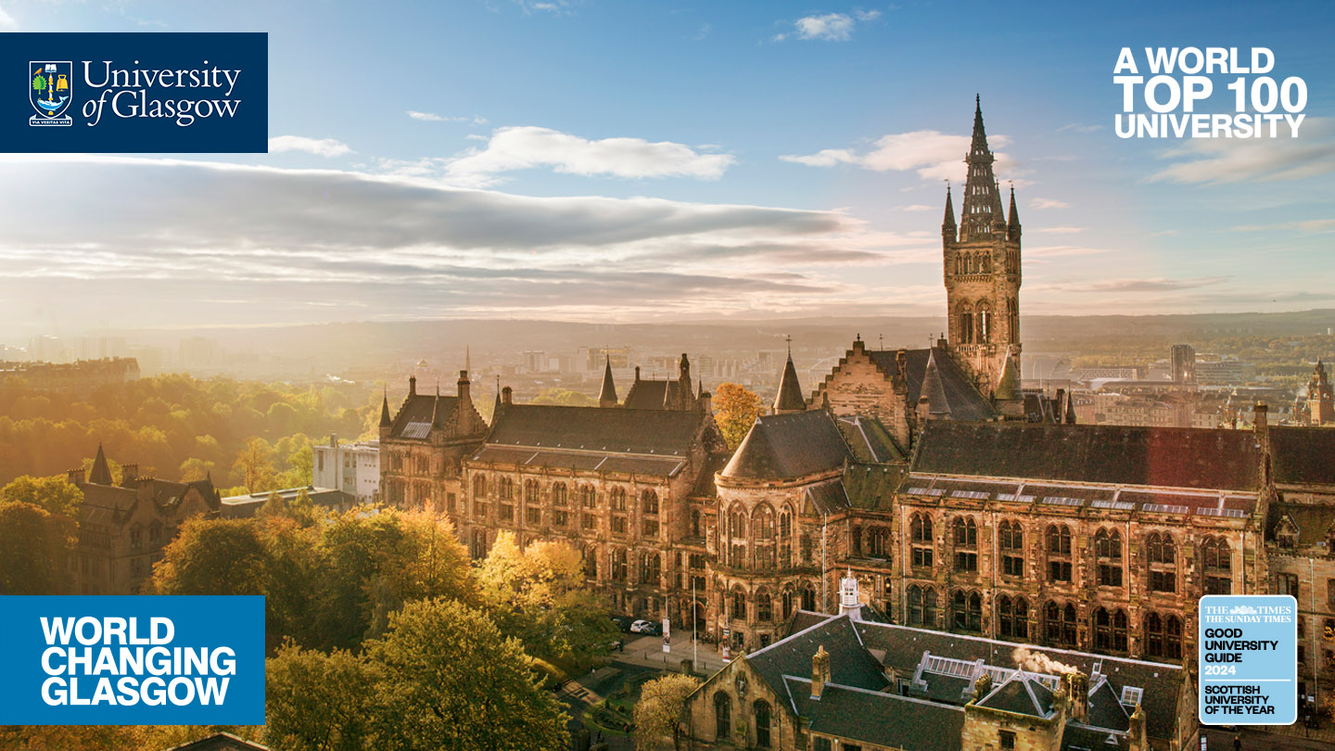
Statistics and AI for Uncertainty Quantification in Applied Mathematical Models
Dr Vinny Davies, Senior Lecturer in Statistics
School of Mathematics & Statistics, University of Glasgow

Slide 2
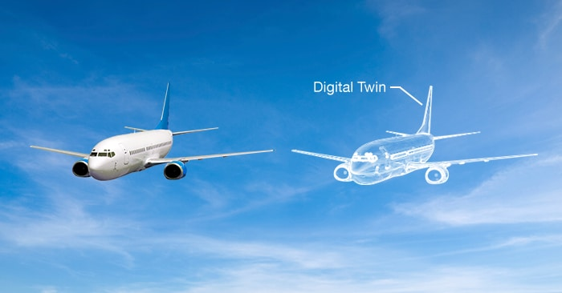
What is a Digital Twin?
A digital twin is essentially a digital replica of some real-life process
Generally, the digital twin will be a computerised version of the real-life process that allows us to simulate the process and understand what would happen in different situations

Slide 3


So, what actually is a Digital Twin?
Digital Twin
Real System

Slide 4
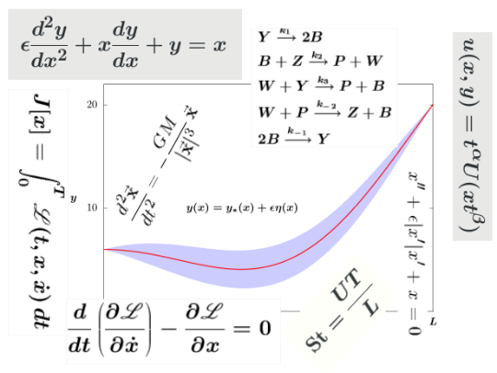
So, what actually is a Digital Twin?
Physical Model
Digital Twin
Real System

Slide 5
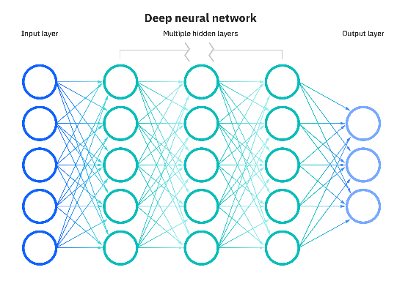
So, what actually is a Digital Twin?
ML / AI Model
Digital Twin
Real System

Slide 6

So, what actually is a Digital Twin?
Digital Twin
Real System
Code

Slide 7
So, what actually is a Digital Twin?
Physical Model
ML / AI Model
Digital Twin
Real System
Code

Slide 8
So, what actually is a Digital Twin?
Digital Twin
Physical Model
ML / AI Model
Digital Twin
Real System
Code

Slide 9
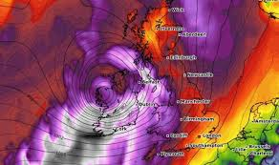
So, what actually is a Digital Twin?
Weather Data
Digital Twin
Physical Model
ML / AI Model
Digital Twin
Code

Slide 10
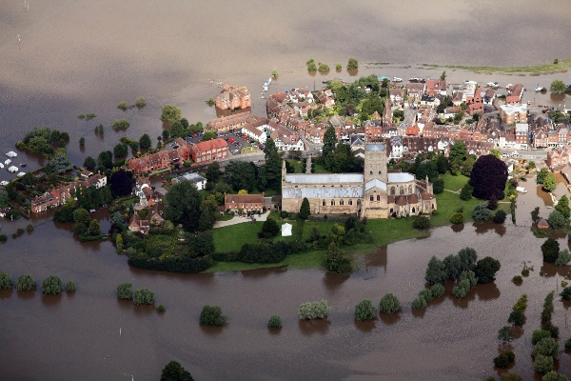
So, what actually is a Digital Twin?
Weather Data
Digital Twin
Physical Model
Flooding Data
ML / AI Model
Digital Twin
Code

Slide 11
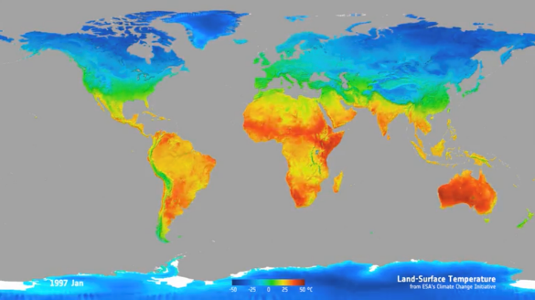
So, what actually is a Digital Twin?
Weather Data
Digital Twin
Physical Model
Flooding Data
ML / AI Model
Temperature Data
Digital Twin
Code

Slide 12
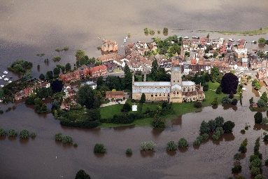

So, what actually is a Digital Twin?
Data
Digital Twin
Physical Model
ML / AI Model
Digital Twin
Code

Slide 13
So, what actually is a Digital Twin?
Training models and parameters
We can use the combination of our digital twin and available data to train the models and parameters of the digital twin
Data
Digital Twin
Physical Model
ML / AI Model
Digital Twin
Code

Slide 14
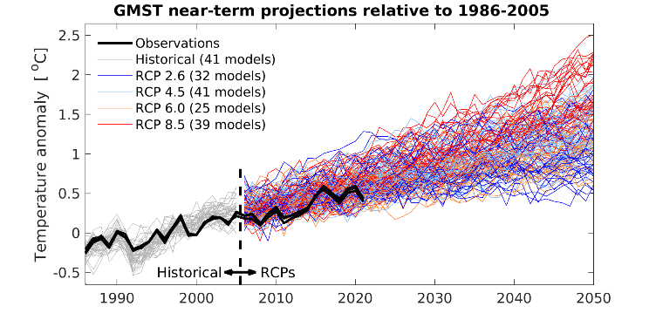
So, what actually is a Digital Twin?
Training models and parameters
We can use the combination of our digital twin and available data to train the models and parameters of the digital twin
Data
Digital Twin
Physical Model
ML / AI Model
Scenario Planning
Digital Twin
Code

Slide 15
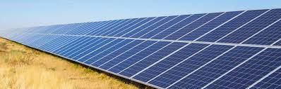
So, what actually is a Digital Twin?
Training models and parameters
We can use the combination of our digital twin and available data to train the models and parameters of the digital twin
Data
Digital Twin
Physical Model
ML / AI Model
Scenario Planning
Digital Twin
Tool / Intervention
Code

Slide 16

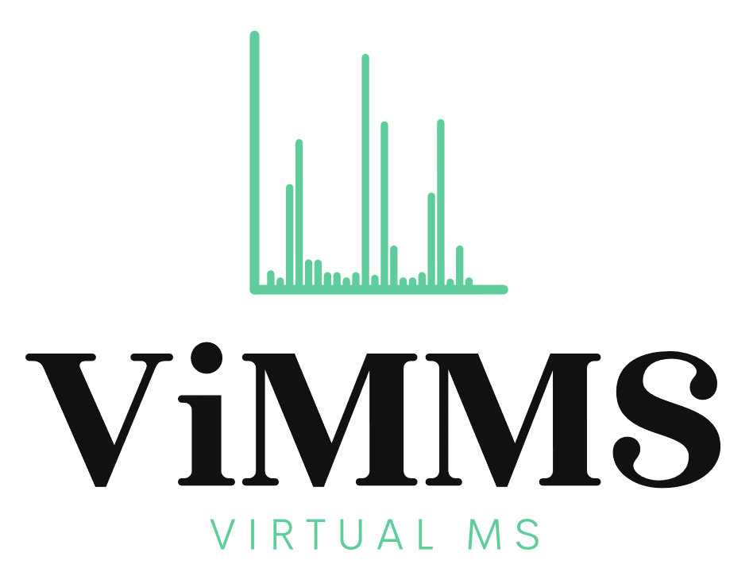
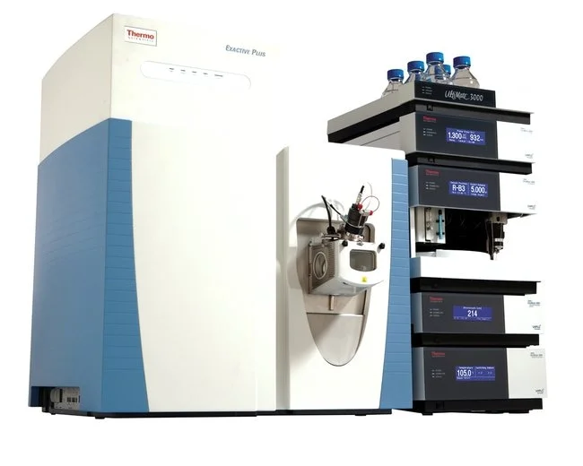
Mass Spectrometry
We have developed a digital twin of a Mass Spectrometer
Virtual Metabolomics Mass Spectrometer (ViMMS) allows us to simulate entire experiment and develop new methods for real time data acquisition

Slide 17
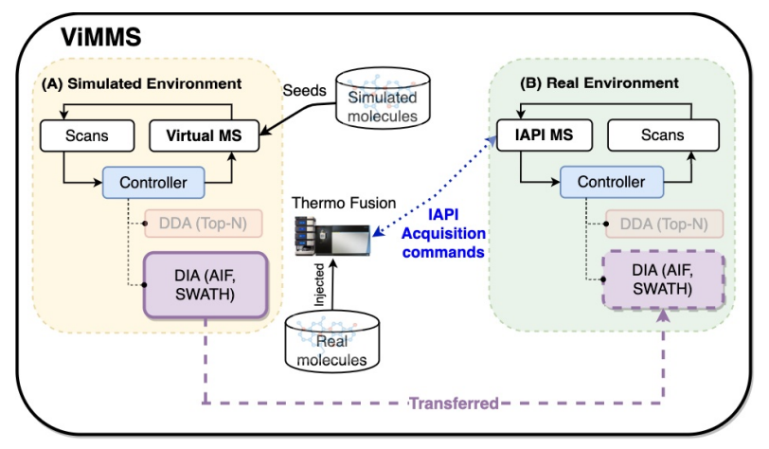
Mass Spectrometry
Methods can be developed and optimised in a simulated environment and then deployed in real experiments through an API
Scans are controlled and scheduled on the fly, allowing us to adjust to real time changes in the chemicals we observed

Slide 18
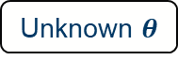

Mass Spectrometry
We have developed a complete pipeline for the streamlined development of new methods
The pipeline is designed to minimise the costly mass spectrometer time
Simulated Results
Unknown $θ$
Simulated Results
Optimised $θ$
Real Results
Prototype
Controller
Controller
Controller

Slide 19
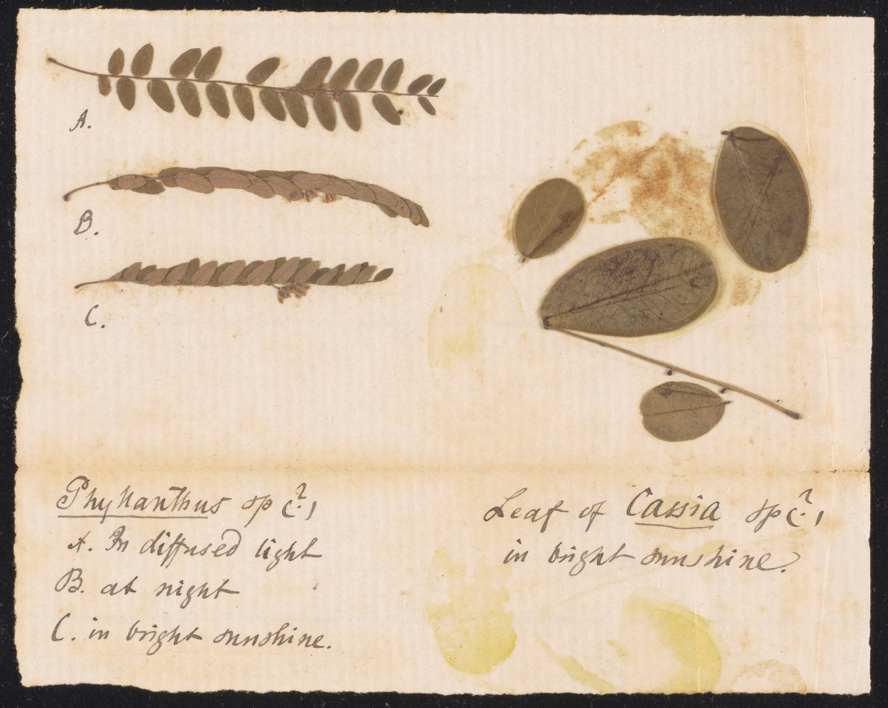
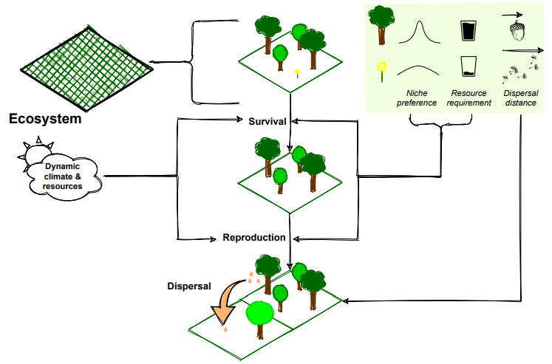
Biodiversity
Working with MVLS colleague to do inference and parameter estimation in a biodiversity digital twin
Takes records from the Natural History Museum and uses them to inform the mathematical model

Slide 20
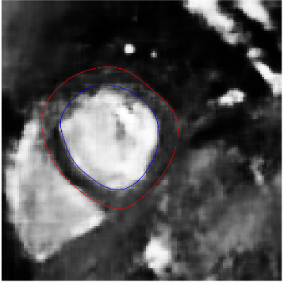
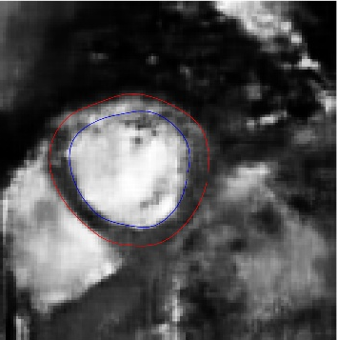
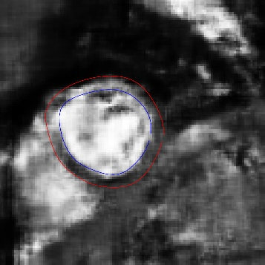
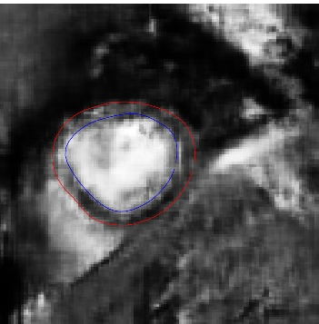
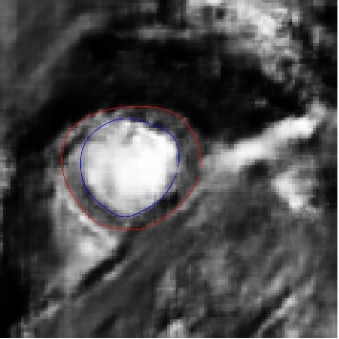
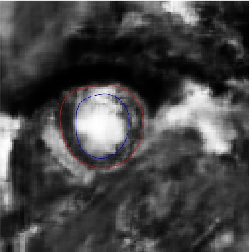

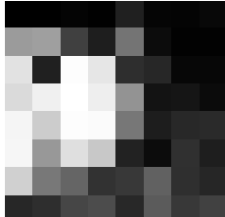
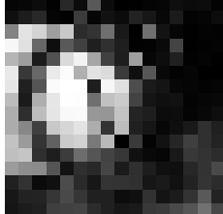
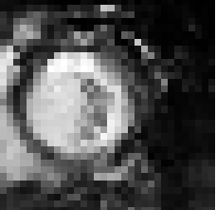
Cardiac Mechanics
Work related to emulation methods for Cardiac Mechanics
Aim – to speed up how we do parameters inference for mathematical models to make them clinically relevant
Fake Image generation using Generative AI
PCI Planning (grant led by Sean McGinty)
Left Ventricle Emulation
Progressive GAN on Heart Data

Slide 21

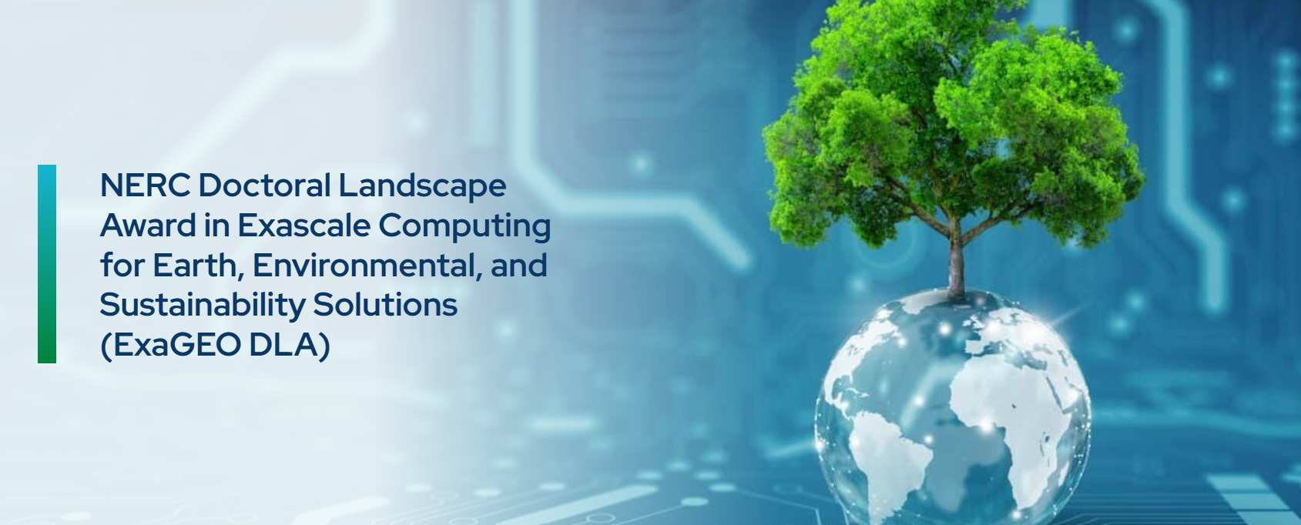
Geographics and Earth Sciences
New projects related to uncertainty quantification in geographic finite element models
Potential peatland modelling project (with Raimondo Penta and others)

Slide 22
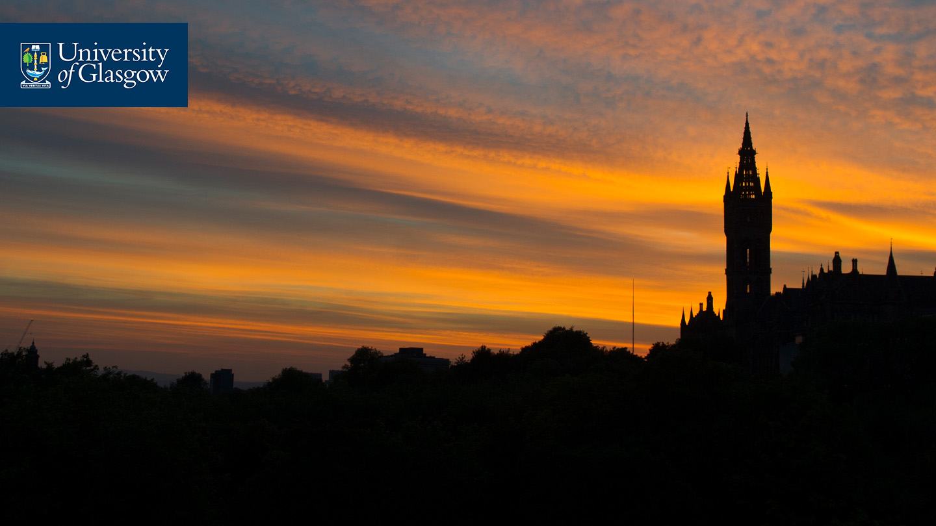



If you are interested in collaborating then you can contact me at Vinny.Davies@Glasgow.ac.uk Slides available at https://github.com/vinnydavies/presentations
#UofGWorldChangers
@UofGlasgow

